Slide 1

Note: The data and information in this document is reflective of a hypothetical situation and client. This document is to be used for KPMG Virtual Internship purposes only.
Sprocket Central Pty Ltd
Data analytics approach
Precious Aguluka.

Slide 2
Note: The data and information in this document is reflective of a hypothetical situation and client. This document is to be used for KPMG Virtual Internship purposes only.
DATA LOADING
Introduction
Data Exploration
Interpretation

Slide 3

Note: The data and information in this document is reflective of a hypothetical situation and client. This document is to be used for KPMG Virtual Internship purposes only.
Introduction
Project Goal
Objective: Identify high-value new customers for Sprocket Central.
Approach: Data-driven analysis of existing customer data and new prospect attributes.
Outcome: Optimized resource allocation and boosted business performance.
Data-driven targeting for maximum impact.
This Photo by Unknown author is licensed under CC BY-NC.

Slide 4
Note: The data and information in this document is reflective of a hypothetical situation and client. This document is to be used for KPMG Virtual Internship purposes only.
2. DATA EXPLORATION
DATASETS
The Four datasets identify from Sprocket Central Pty Ltd Excel Spreadsheet are:
Transactions
Customer Address
Customer Demographic
New Customer List
Customer demographic and customer Address dataset were merge on 'customer id' to form a new data frame called Old Customer List
Customer Address has three invalid customer Id above 4000 (4001, 4002 and 4003)
Customer Address has 3999 rows while customer demographic has 4000 rows
After the merge on customer id, Old Customer List has 3996 rows with customer id ranging from 1 to 4000.
The are 4 customers without customer address information which were not included
The dataset are thus, reduce to three.

Slide 5
Note: The data and information in this document is reflective of a hypothetical situation and client. This document is to be used for KPMG Virtual Internship purposes only.
2. DATA EXPLORATION
TRANSACTION DATA FRAME
Statistical view of Transaction data frame numerical columns
 | transaction_id | product_id | customer_id | transaction_date | online_order | list_price | standard_cost | product_first_sold_date
count | 20000.000000 | 20000.00000 | 20000.000000 | 20000 | 19640.000000 | 20000.000000 | 19803.000000 | 19803.000000
mean | 10000.500000 | 45.36465 | 1738.246050 | 2017-07-01 14:08:05.280000 | 0.500458 | 1107.829449 | 556.046951 | 38199.776549
min | 1.000000 | 0.00000 | 1.000000 | 2017-01-01 00:00:00 | 0.000000 | 12.010000 | 7.210000 | 33259.000000
25% | 5000.750000 | 18.00000 | 857.750000 | 2017-04-01 00:00:00 | 0.000000 | 575.270000 | 215.140000 | 35667.000000
50% | 10000.500000 | 44.00000 | 1736.000000 | 2017-07-03 00:00:00 | 1.000000 | 1163.890000 | 507.580000 | 38216.000000
75% | 15000.250000 | 72.00000 | 2613.000000 | 2017-10-02 00:00:00 | 1.000000 | 1635.300000 | 795.100000 | 40672.000000
max | 20000.000000 | 100.00000 | 5034.000000 | 2017-12-30 00:00:00 | 1.000000 | 2091.470000 | 1759.850000 | 42710.000000
std | 5773.647028 | 30.75359 | 1011.951046 | NaN | 0.500013 | 582.825242 | 405.955660 | 2875.201110

Slide 6
Note: The data and information in this document is reflective of a hypothetical situation and client. This document is to be used for KPMG Virtual Internship purposes only.
2. DATA EXPLORATION
Transactions DATA FRAME
There are 13 columns and 20,000 rows. The following are the information of the columns;
Transaction id
Product id
Customer id
Transaction date
Online order
Order status
Brand
Product line
Product class
Product size
List price
Standard cost
Product first sold date
The data types are summarized as follows: datetime64[ns](1), float64(4), int64(3), object(5) memory usage: 2.0+ MB

Slide 7
Note: The data and information in this document is reflective of a hypothetical situation and client. This document is to be used for KPMG Virtual Internship purposes only.
2. DATA EXPLORATION
Old Customer List DATA FRAME
Statistical view of Old Customer List data frame numerical columns
 | customer_id | past_3_years_bike_related_purchases | tenure | postcode | property_valuation
count | 3996.000000 | 3996.000000 | 3909.000000 | 3996.000000 | 3996.000000
mean | 2002.487988 | 48.880881 | 10.655922 | 2985.735485 | 7.514014
std | 1153.710903 | 28.724636 | 5.658533 | 844.945641 | 2.825426
min | 1.000000 | 0.000000 | 1.000000 | 2000.000000 | 1.000000
25% | 1003.750000 | 24.000000 | 6.000000 | 2200.000000 | 6.000000
50% | 2002.500000 | 48.000000 | 11.000000 | 2768.000000 | 8.000000
75% | 3001.250000 | 73.000000 | 15.000000 | 3750.000000 | 10.000000
max | 4000.000000 | 99.000000 | 22.000000 | 4883.000000 | 12.000000

Slide 8
Note: The data and information in this document is reflective of a hypothetical situation and client. This document is to be used for KPMG Virtual Internship purposes only.
2. DATA EXPLORATION
OLD CUSTOMER LIST DATA FRAME
There are 18 columns and 3996 rows. The following are the columns;
Customer id
First name
Last name
gender
Past 3 years bike related purchases
DOB
Job title
Job industry category
Wealth segment
Deceased indicator
default
Owns car
Tenure
Address​
Postcode​
State​
country​
Property valuation ​
The data types are summarized as follows: float64(1), int64(4), object(13)​

Slide 9
Note: The data and information in this document is reflective of a hypothetical situation and client. This document is to be used for KPMG Virtual Internship purposes only.
2. DATA EXPLORATION
NEW CUSTOMER List DATA FRAME
 | past_3_years_bike_related_purchases | tenure | postcode | property_valuation | Unnamed: 16 | Unnamed: 17 | Unnamed: 18 | Unnamed: 19 | Unnamed: 20 | Rank | Value
count | 1000.000000 | 1000.000000 | 1000.000000 | 1000.000000 | 1000.000000 | 1000.000000 | 1000.000000 | 1000.000000 | 1000.000000 | 1000.000000 | 1000.000000
mean | 49.836000 | 11.388000 | 3019.227000 | 7.397000 | 0.747340 | 0.839005 | 0.942673 | 0.870514 | 498.819000 | 498.819000 | 0.881714
std | 27.796686 | 5.037145 | 848.895767 | 2.758804 | 0.205082 | 0.248858 | 0.294832 | 0.280891 | 288.810997 | 288.810997 | 0.293525
min | 0.000000 | 0.000000 | 2000.000000 | 1.000000 | 0.400000 | 0.400000 | 0.400000 | 0.340000 | 1.000000 | 1.000000 | 0.340000
25% | 26.750000 | 7.000000 | 2209.000000 | 6.000000 | 0.570000 | 0.637500 | 0.712500 | 0.658750 | 250.000000 | 250.000000 | 0.649531
50% | 51.000000 | 11.000000 | 2800.000000 | 8.000000 | 0.750000 | 0.820000 | 0.912500 | 0.842625 | 500.000000 | 500.000000 | 0.860000
75% | 72.000000 | 15.000000 | 3845.500000 | 9.000000 | 0.920000 | 1.031875 | 1.142969 | 1.062500 | 750.250000 | 750.250000 | 1.075000
max | 99.000000 | 22.000000 | 4879.000000 | 12.000000 | 1.100000 | 1.375000 | 1.718750 | 1.718750 | 1000.000000 | 1000.000000 | 1.718750

Slide 10
Note: The data and information in this document is reflective of a hypothetical situation and client. This document is to be used for KPMG Virtual Internship purposes only.
2. DATA EXPLORATION
NEW CUSTOMER LIST DATA FRAME
There are 23 columns and 1000 rows. The following are the columns;
First name
Last name
Gender
Past 3 years bike related purchases
DOB
Job title
Job industry category
Wealth segment
Deceased indicator
Owns car
tenure
Address
Postcode
State
Country
Property valuation
Unnamed: 16
Unnamed: 17
Unnamed: 18
Unnamed: 19
Unnamed: 20
Rank
Value
The data types are summarized as follows: float64(5), int64(6), object(12)

Slide 11
Note: The data and information in this document is reflective of a hypothetical situation and client. This document is to be used for KPMG Virtual Internship purposes only.
3. INTREPRETATION
DATASET INTREPRETATION AFTER LOADING
Inconsistent columns: the following columns are either only present in one of the customer list and absent in the other
'Unnamed: 16',
'Unnamed: 17',
'Unnamed: 18',
'Unnamed: 19',
'Unnamed: 20',
'Rank',
'Value'
Default
Missing value: There are missing values in all the data frames after loading
Invalid Data Type: datetime such as DOB and product first sold date were identified as object instead of datetime data type.
Inconsistent values for categorical feature: such as Female and F, victoria and VIc.
Outliers: there might be some outliers present

Slide 12
Note: The data and information in this document is reflective of a hypothetical situation and client. This document is to be used for KPMG Virtual Internship purposes only.
DATA CLEANING
Terminologies
Method for cleaning missing values.
Handling categorical variables.
Inconsistent values and columns, Invalid data type and outliers.
Interpretation.

Slide 13
Note: The data and information in this document is reflective of a hypothetical situation and client. This document is to be used for KPMG Virtual Internship purposes only.
TERMINOLOGIES
Mean Absolute Error(MAE): is a metric used to measure the average magnitude of errors in a set of predictions, without considering their direction. It is calculated as the average of the absolute differences between predicted and actual values.
MAE = (1/n) * Σ |yi - ŷi|
n is the number of observations
yi is the actual value
ŷi is the predicted value
the lowest MAE is considered the best, as it indicates the smallest average error between predicted and actual values.
RandomForestRegressor Model: This is a machine learning model from the ensemble learning family, specifically used for regression tasks.
It builds multiple decision trees during training and outputs the average prediction of the individual trees to improve predictive accuracy and control over-fitting.
For predicting the ŷi values, this model will be used at a random state of zero(0) to ensure that the model to produce the same results every time it is run.

Slide 14
Note: The data and information in this document is reflective of a hypothetical situation and client. This document is to be used for KPMG Virtual Internship purposes only.
TERMINOLOGIES
Y-dot notation: at the beginning of this data analysis process. But based on my general knowledge of the feature.
List price and past_3_years_bike_related will used as the y dot notation for Transactions and Old Customer List data frames respectively for the data cleaning process.
The y dot notation is the target variable for predicting high value customers in the respective data frame.
During the feature inspection and feature engineering processing. The Y target variable might the subject to change as my understanding of the relationships between the features increases.
X-features:
Missing values: all feature in each data frame except from the y-dot notation and high cardinality features will be used as the X-features during the data cleaning process
The following are the high cardinality columns
First name (3136 )
Last name (3721)
Address (3993)
Job title(195)

Slide 15
Note: The data and information in this document is reflective of a hypothetical situation and client. This document is to be used for KPMG Virtual Internship purposes only.
2. METHOD FOR CLEANING MISSING VALUES
We will be choosing the optimal MAE results out of the following two methods:
Dropping columns with missing values
Imputation using simple Imputer
Approach | Transactions_df MAE | OldCustomerList_df MAE
Dropping columns | 156.90 | 26.83
Imputation | 7.38 | 25.85
the MAE results above indicate that Approach 2 (imputation) outperformed Approach 1 (dropping columns) in terms of MAE for both datasets.
We will be using this approach for data cleaning and preprocessing.

Slide 16
Note: The data and information in this document is reflective of a hypothetical situation and client. This document is to be used for KPMG Virtual Internship purposes only.
3. METHOD FOR HANDLING CATEGORICAL VARIABLES
We will be choosing the optimal MAE results out of the following two methods:
Drop categorical columns
Ordinal Encoding
Approach | Transactions_df MAE | OldCustomerList_df MAE
Dropping categorical columns | 8.01 | 25.56
Ordinal Encoding | 5.87 | 25.51
The MAE for Transactions_df decreased by 26.7% (from 8.01 to 5.87) when using ordinal encoding instead of dropping categorical values. Similarly, the MAE for OldCustomerList_df decreased by 0.2% (from 25.56 to 25.51) with ordinal encoding.
Converting categorical values to numerical representations will enable us retain valuable information.

Slide 17
Note: The data and information in this document is reflective of a hypothetical situation and client. This document is to be used for KPMG Virtual Internship purposes only.
4. Inconsistent values and columns, Invalid data type and outliers.
Inconsistent Values:
Old Customer List:
Gender column :{'Femal': 'Female', 'M': 'Male', 'F': 'Female'}
State column : {'New South Wales': 'NSW', 'Victoria': 'VIC'}
Inconsistent columns:
Old Customer List: the following columns were dropped
'default'
New Customer List: the following columns were dropped
'Unnamed: 16', 'Unnamed: 17', 'Unnamed: 18', 'Unnamed: 19', 'Unnamed: 20', 'Rank', 'Value'
Invalid data type:
Old Customer List: DOB was converted from days to datetime data type
New Customer List: DOB was converted from days to datetime data type
Transactions: Product first sold date was converted fro days to datetime data type
Outliers: A graphical representation of the outlier found in the datasets below is in the next slide.
Old Customer List
New Customer list.

Slide 18
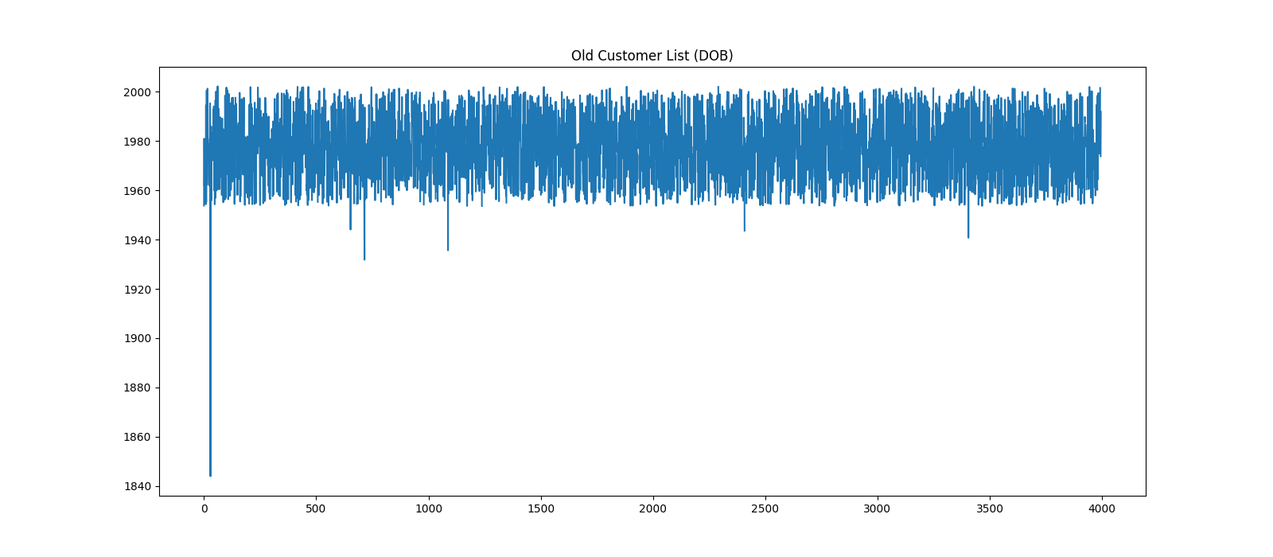
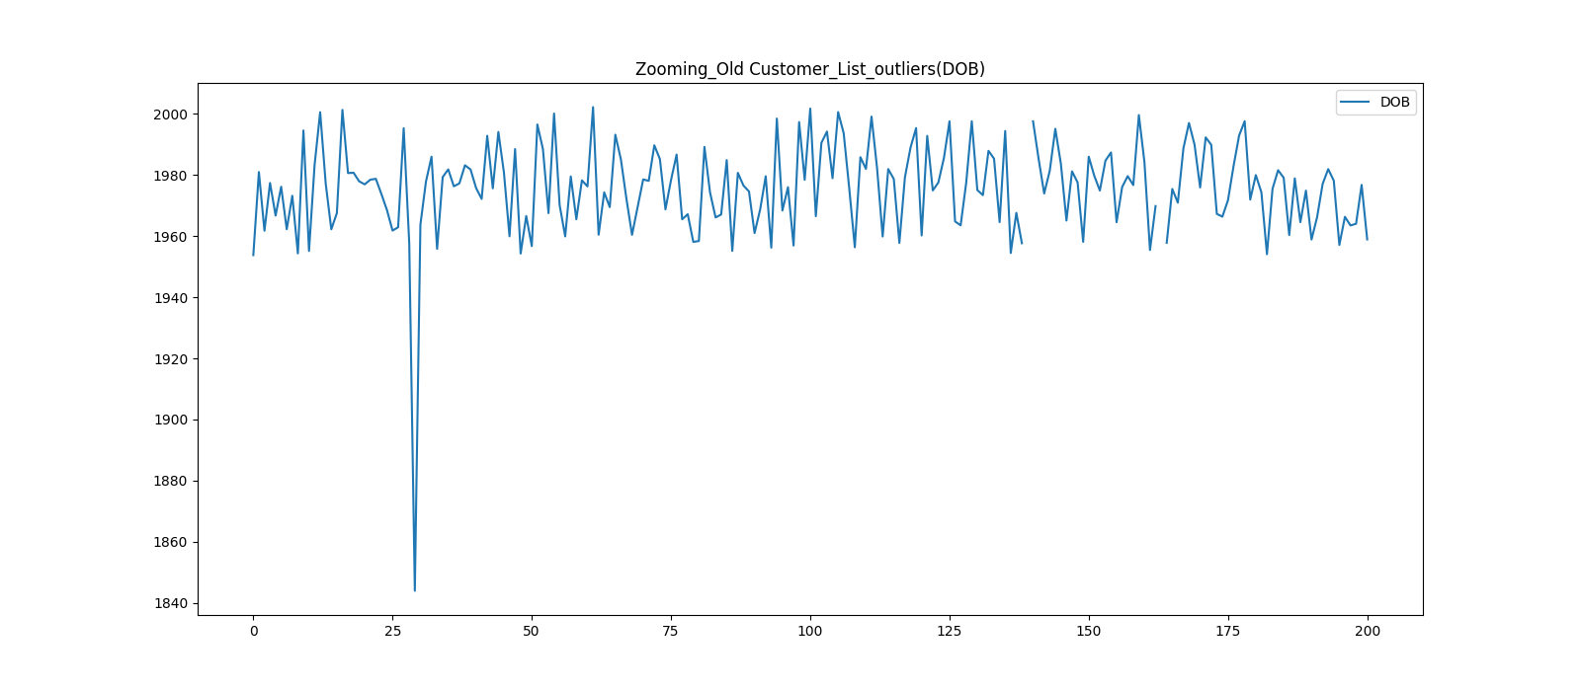
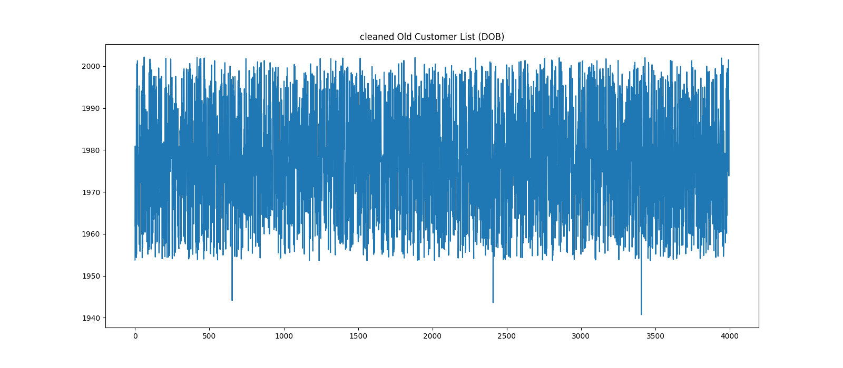
Note: The data and information in this document is reflective of a hypothetical situation and client. This document is to be used for KPMG Virtual Internship purposes only.
4. outliers(Old Customer List)
There are missing values and outliers in the Date of Birth column
The missing value will be clean using the simple imputer(strategy=mean)
The outliers has been cleaned analytically by dropping the values less than the upper limit.
The code for calculating the upper limit is:
data frame['column'].mean() + 2 * iqr
Iqr is the inter quatile range(Q3-Q1), it is not sensitive to outliers.

Slide 19
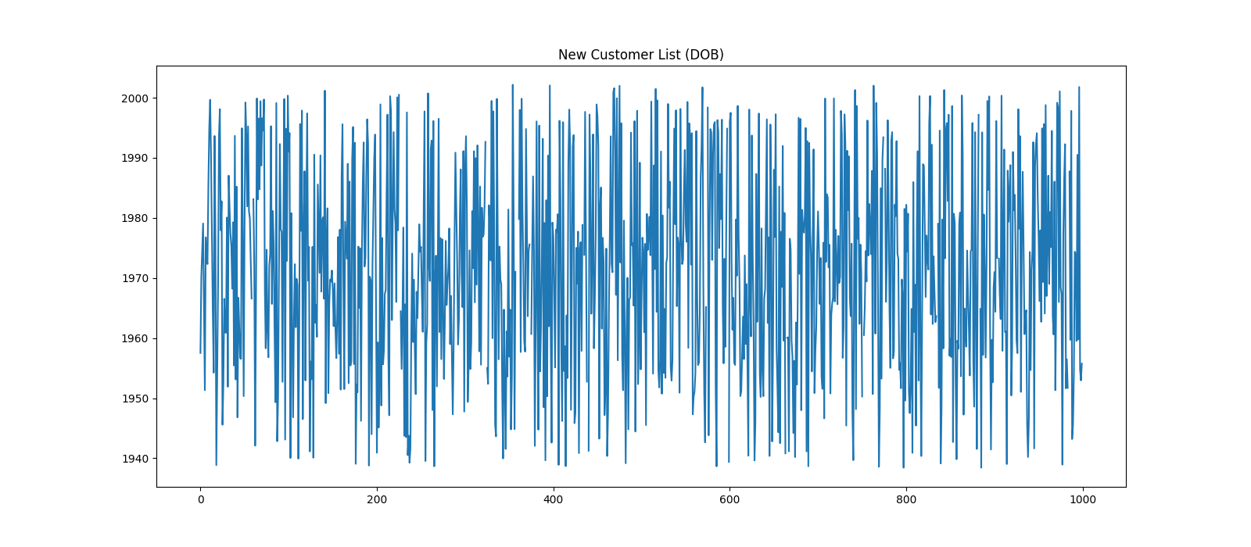
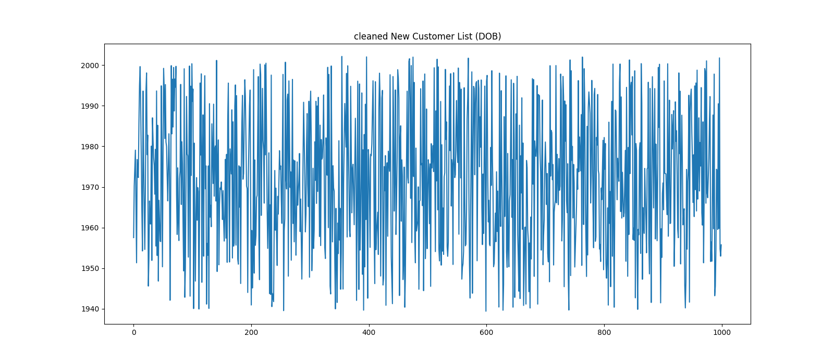
Note: The data and information in this document is reflective of a hypothetical situation and client. This document is to be used for KPMG Virtual Internship purposes only.
4. outliers(New Customer List)
There are missing values and outliers in the Date of Birth column
The missing value will be clean using the simple imputer(strategy=mean)
The outliers has been cleaned analytically by dropping the values less than the upper limit.
The code for calculating the upper limit is:
data frame['column'].mean() + 2 * iqr
Iqr is the inter quantile range(Q3-Q1), it is not sensitive to outliers.

Slide 20
Note: The data and information in this document is reflective of a hypothetical situation and client. This document is to be used for KPMG Virtual Internship purposes only.
5. DATA CLEANING INTERPRETATION
Cleaning the data resulted in an improved MAE result as showed below;
Data Frame | Improved MAE
Transactions | 4.95
Old Customer List | 24.628
While the MAE is seen to reduce for the both data frame. It should be noted that 0 MAE indicate a perfect prediction and for Old customer List. The MAE result is high.
The data cleaning process was done in a data pipepline to ensure a cleaner code and few bugs.
The following section such as feature inspection, engineering, model development and evaluation. We will see various means to further improve the model prediction.

Slide 21
Note: The data and information in this document is reflective of a hypothetical situation and client. This document is to be used for KPMG Virtual Internship purposes only.
FEATURE INSPECTION
TRANSACTIONS SHAP SUMMARY PLOT
TRANSACTIONS SHAP DEPENDENCE CONTRIBUTION PLOTS AND INTERPRETATION OF INSPECTION.
CONCLUSION OF TRANSACTIONS DATA FRAME INSPECTION
OLD CUSTOMER LIST SHAP SUMMARY PLOT
OLD CUSTOMER LIST SHAP DEPENDENCE CONTRIBUTION PLOTS
CONCLUSION OF OLD CUSTOMER LIST DATA FRAME INSPECTION.

Slide 22
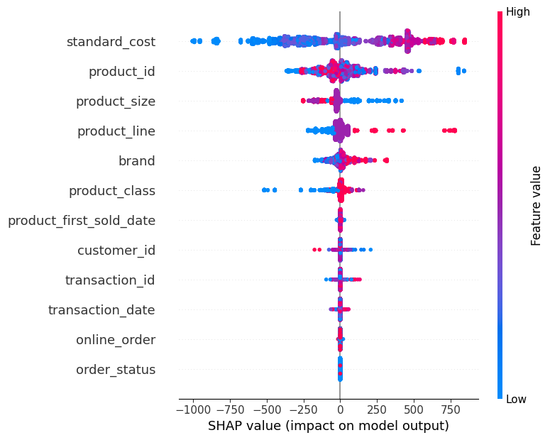
Note: The data and information in this document is reflective of a hypothetical situation and client. This document is to be used for KPMG Virtual Internship purposes only.
1. TRANSACTIONS SHAP SUMMARY PLOT

Slide 23
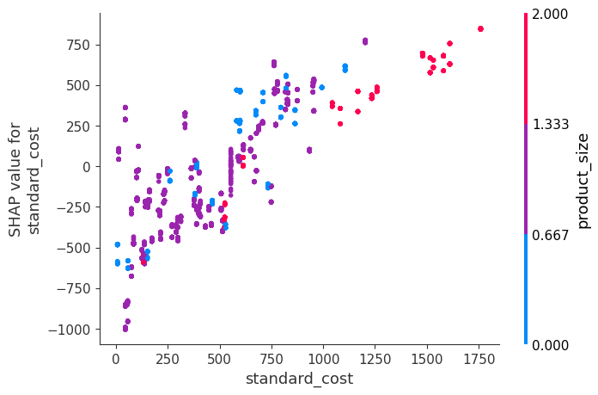
Note: The data and information in this document is reflective of a hypothetical situation and client. This document is to be used for KPMG Virtual Internship purposes only.
2. TRANSACTIONS SHAP DEPENDENCE CONTRIBUTION PLOTS AND INTERPRETATION OF INSPECTION
Standard Cost: According to our model, This is the most important feature. which is reasonable as the selling price(list price) will definitely be influenced by the standard cost(cost price).
as seen by the SHAP summary plot, High values of Standard Cost caused higher predictions, and low values caused low predictions.
this means the higher the standard cost, the higher the list price and vice-versa.
This suggests a strong positive correlation between standard cost and list price.
Standard cost also has a interaction effect with product size.

Slide 24
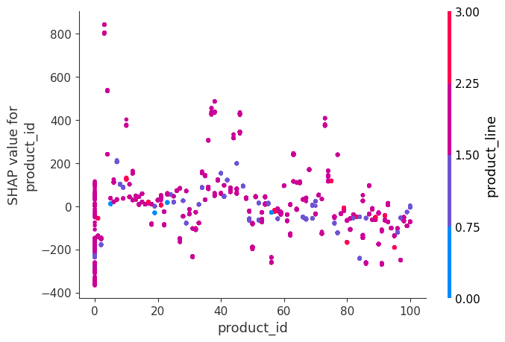
Note: The data and information in this document is reflective of a hypothetical situation and client. This document is to be used for KPMG Virtual Internship purposes only.
2. TRANSACTIONS SHAP DEPENDENCE CONTRIBUTION PLOTS AND INTERPRETATION OF INSPECTION
Product id: There exist a jumbling which suggests that both high and low values of the Product id can have both positive and negative effects on the list price.
The jumbling of the values indicate that product_id has an interaction effect with other variables such as product line
However, there is an extreme case where a low value close to 0 caused a much higher prediction, this suggests a non-linear relationship

Slide 25
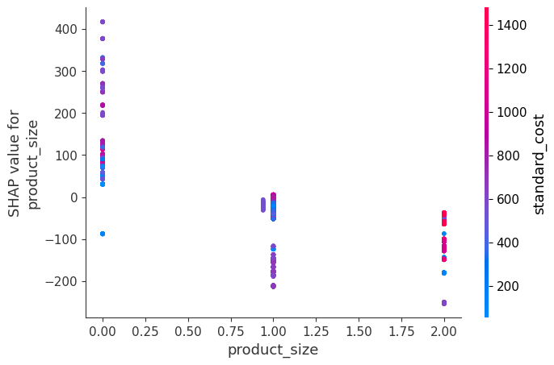
Note: The data and information in this document is reflective of a hypothetical situation and client. This document is to be used for KPMG Virtual Internship purposes only.
2. TRANSACTIONS SHAP DEPENDENCE CONTRIBUTION PLOTS AND INTERPRETATION OF INSPECTION
Product size: product size has the following unique values ['medium' 'large' 'small'].
according to the ordinal encoder [0, 1, 2] respectively.
low values of product size ('medium') caused higher predictions
high and medium values of product size ('large' 'small') lowered the prediction(list price).

Slide 26
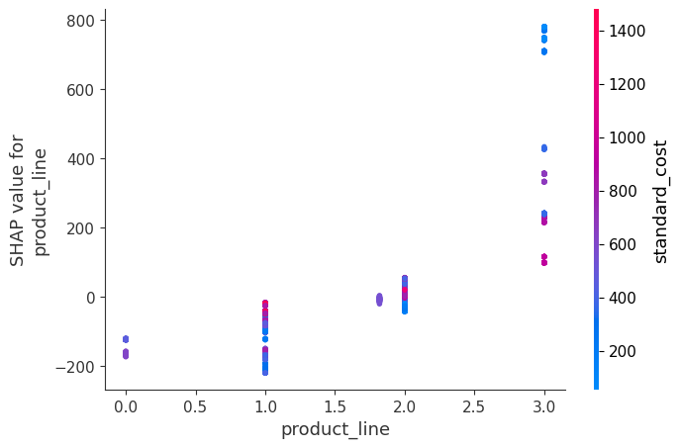
Note: The data and information in this document is reflective of a hypothetical situation and client. This document is to be used for KPMG Virtual Internship purposes only.
2. TRANSACTIONS SHAP DEPENDENCE CONTRIBUTION PLOTS AND INTERPRETATION OF INSPECTION
Product line: product line has the following unique values ['Standard' 'Road' 'Mountain' 'Touring'].
according to the ordinal encoder [0, 1, 2, 3] respectively.
high values of product line ('touring') caused higher predictions.

Slide 27
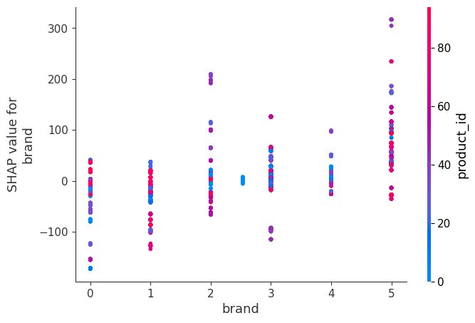
Note: The data and information in this document is reflective of a hypothetical situation and client. This document is to be used for KPMG Virtual Internship purposes only.
2. TRANSACTIONS SHAP DEPENDENCE CONTRIBUTION PLOTS AND INTERPRETATION OF INSPECTION
Brand: Brand has the following unique values ['Solex' 'Trek Bicycles' 'OHM Cycles' 'Norco Bicycles' 'Giant Bicycles' 'WeareA2Bn].
according to the ordinal encoder [0, 1, 2, 3, 4, 5] respectively.
The feature interacts with other variables, leading to varying effects on list price.
There is an extreme case where high values if brand WeareA2B() caused higher predictions

Slide 28
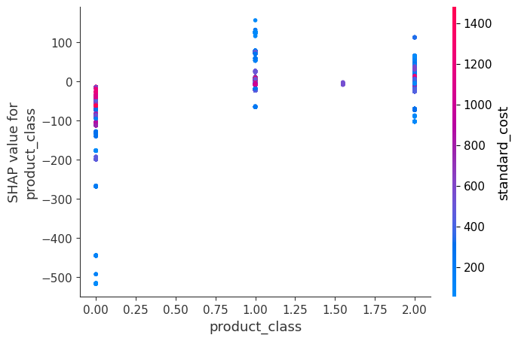
Note: The data and information in this document is reflective of a hypothetical situation and client. This document is to be used for KPMG Virtual Internship purposes only.
2. TRANSACTIONS SHAP DEPENDENCE CONTRIBUTION PLOTS AND INTERPRETATION OF INSPECTION
Product Class: product class has the following unique values ['medium' 'low' 'high'].
According to the ordinal encoder [0, 1, 2] respectively.
The product class low values (medium)result in lower prediction

Slide 29
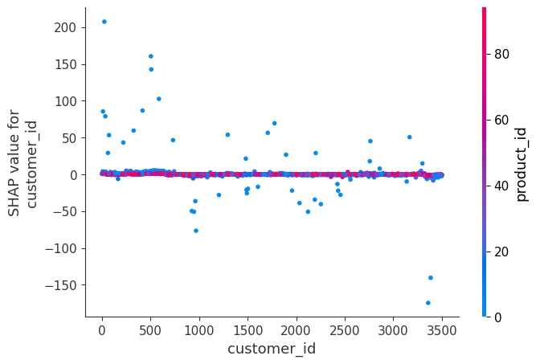
Note: The data and information in this document is reflective of a hypothetical situation and client. This document is to be used for KPMG Virtual Internship purposes only.
2. TRANSACTIONS SHAP DEPENDENCE CONTRIBUTION PLOTS AND INTERPRETATION OF INSPECTION
customer id: In the SHAP dependence plot there are points with similar customer id values,
the same range of value caused one prediction to increase, and it caused the other prediction to decrease.
there also cases where high customer id values reduce predictions.
it is also significant to note that the variation points in the SHAP dependence plot are colored blue(product id from 0 to 20)
The SHAP dependence plot could be interpreted as that older customers (lower customer id values) tend to buy products with lower product id values, which increases the prediction. However, as customer id values increase, the effect diminishes, leading to reduced predictions.

Slide 30
Note: The data and information in this document is reflective of a hypothetical situation and client. This document is to be used for KPMG Virtual Internship purposes only.
2. TRANSACTIONS SHAP DEPENDENCE CONTRIBUTION PLOTS AND INTERPRETATION OF INSPECTION
According to the SHAP summary plot, the following do not feature do not significantly affect the prediction.
Product first sold date
Transaction Id
Transaction date
Online order
Order status

Slide 31
Note: The data and information in this document is reflective of a hypothetical situation and client. This document is to be used for KPMG Virtual Internship purposes only.
3. CONCLUSION OF TRANSACTIONS DATA FRAME INSPECTION
The following features will be used during the feature engineering process as suggested by the SHAP summary plot.
Standard cost
Product id
Product size
Product line
brand
Product class
Customer id

Slide 32
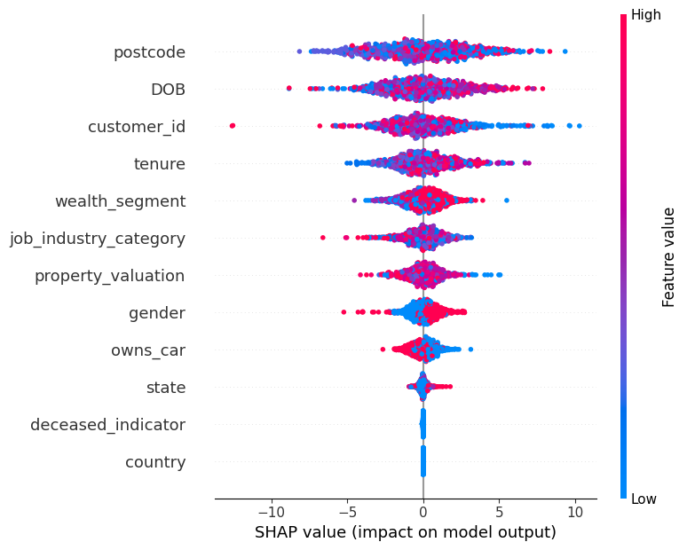
Note: The data and information in this document is reflective of a hypothetical situation and client. This document is to be used for KPMG Virtual Internship purposes only.
4. OLD CUSTOMER LIST SHAP SUMMARY PLOT

Slide 33
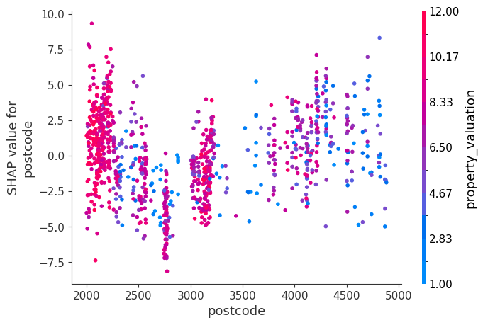
Note: The data and information in this document is reflective of a hypothetical situation and client. This document is to be used for KPMG Virtual Internship purposes only.
5. OLD CUSTOMER LIST SHAP DEPENDENCE CONTRIBUTION PLOTS AND INTERPRETATION OF INSPECTION
Postcode: According to our model, This is the most important feature to predicting the high value customer through the past 3 years related purchases(spending habit).
High and low values of the postcode can have both positive and negative effects on past 3 years related purchase.
the jumbling of the colors suggest that postcode has an interaction with other features.
For instance, the highest effect on prediction is a high value of property valuation and low value of postcode(New south wales areas.)

Slide 34
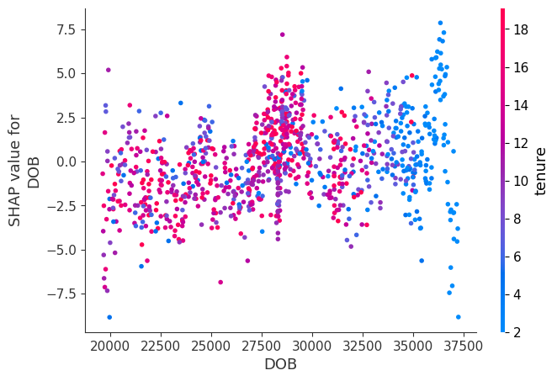
Note: The data and information in this document is reflective of a hypothetical situation and client. This document is to be used for KPMG Virtual Internship purposes only.
5. OLD CUSTOMER LIST SHAP DEPENDENCE CONTRIBUTION PLOTS AND INTERPRETATION OF INSPECTION
DOB: The spread of points along the SHAP value axis indicates variability in the impact of 'DOB' on predictions, highlighting its importance in the model.
Points with higher 'tenure' (in red) generally show higher SHAP values for 'DOB', suggesting that as tenure increases, the impact of 'DOB' on the model's predictions also increases.
There is a noticeable cluster of points where 'DOB' values are between 27500 and 30000(middle-age), showing varied SHAP values. This indicates a significant impact of 'DOB' on predictions within this range

Slide 35
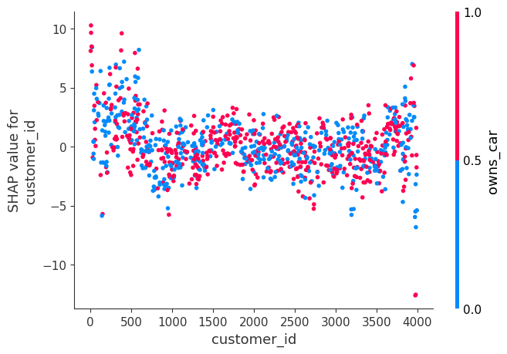
Note: The data and information in this document is reflective of a hypothetical situation and client. This document is to be used for KPMG Virtual Internship purposes only.
5. OLD CUSTOMER LIST SHAP DEPENDENCE CONTRIBUTION PLOTS AND INTERPRETATION OF INSPECTION
Customer id: The plot does not show a strong, clear pattern indicating that 'customer id' alone might not have a significant direct effect on the model's predictions.
The color gradient represents the 'owns_car' feature, with blue indicating owning a car (0) and pink indicating not owning a car (1).
There are some noticeable differences in SHAP values for customers who own a car compared to those who do not, suggesting that car ownership has an interaction effect with customer ID on the model's predictions.

Slide 36
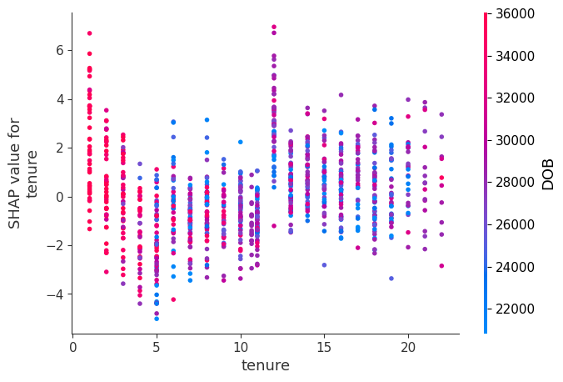
Note: The data and information in this document is reflective of a hypothetical situation and client. This document is to be used for KPMG Virtual Internship purposes only.
5. OLD CUSTOMER LIST SHAP DEPENDENCE CONTRIBUTION PLOTS AND INTERPRETATION OF INSPECTION
Tenure: The plot shows a general trend where the SHAP values vary with different tenures.
For tenures less than 5 years, there is a higher variability in SHAP values, indicating a significant impact on the model’s predictions.
As tenure increases, the SHAP values tend to stabilize, suggesting a more consistent contribution to the model's output.

Slide 37
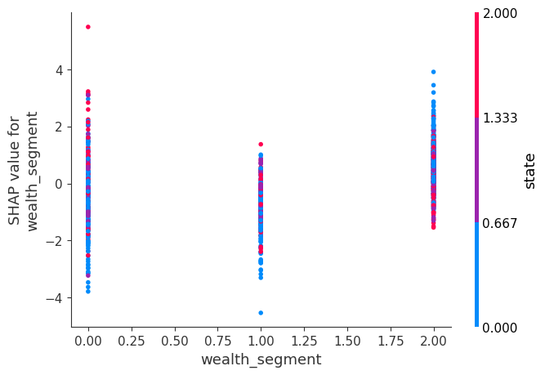
Note: The data and information in this document is reflective of a hypothetical situation and client. This document is to be used for KPMG Virtual Internship purposes only.
5. OLD CUSTOMER LIST SHAP DEPENDENCE CONTRIBUTION PLOTS AND INTERPRETATION OF INSPECTION
Wealth Segment: Wealth segment has the following unique values ['Mass Customer' 'Affluent Customer' 'High Net Worth']
according to the ordinal encoder [0, 1, 2] respectively.
For wealth segment 0(mass customer), there is a wide spread of SHAP values, with some extreme positive and negative impacts on the predictions.
Wealth segments 1 and 2 have more concentrated SHAP values, indicating a more consistent influence on the model's predictions.

Slide 38
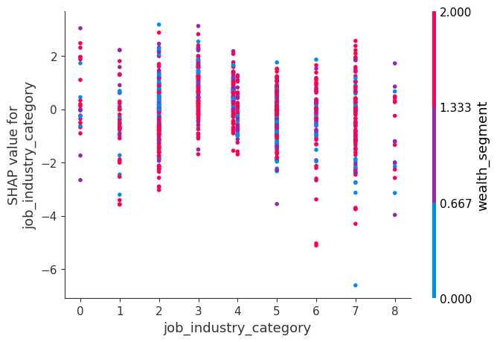
Note: The data and information in this document is reflective of a hypothetical situation and client. This document is to be used for KPMG Virtual Internship purposes only.
5. OLD CUSTOMER LIST SHAP DEPENDENCE CONTRIBUTION PLOTS AND INTERPRETATION OF INSPECTION
Job Industry Category: Job Industry Category has the following unique values ['Health' 'Financial Services', 'IT', 'Retail', 'Agriculture' 'Property' 'Manufacturing' 'Telecommunications' 'Entertainment']
according to the ordinal encoder [0, 1, 2, 3, 4, 5, 6, 7, 8] respectively.
There is a noticeable spread of SHAP values within each category, indicating variability in how different job industries impact the model's predictions..
Categories 3, 4, and 7 show a higher spread of SHAP values, indicating a more substantial and varied impact on the model's predictions.

Slide 39
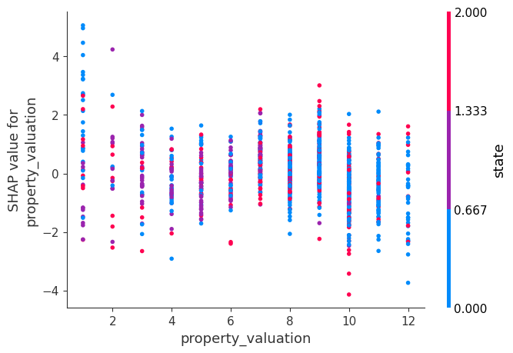
Note: The data and information in this document is reflective of a hypothetical situation and client. This document is to be used for KPMG Virtual Internship purposes only.
5. OLD CUSTOMER LIST SHAP DEPENDENCE CONTRIBUTION PLOTS AND INTERPRETATION OF INSPECTION
Property valuation: The plot shows a general trend where the SHAP values vary with different property valuation.
There is a noticeable spread of SHAP values within each category, indicating variability in how different property valuation impact the model's predictions..
For property valuation 1-4 and 10-12, there is a wide spread of SHAP values, with some extreme positive and negative impacts on the predictions.

Slide 40
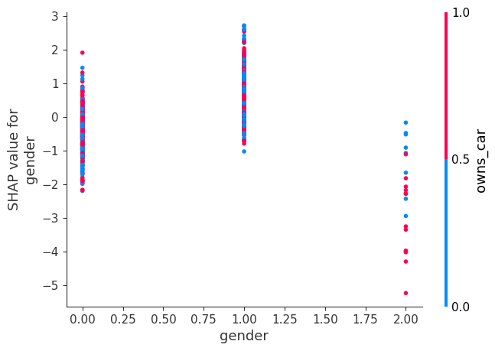
Note: The data and information in this document is reflective of a hypothetical situation and client. This document is to be used for KPMG Virtual Internship purposes only.
5. OLD CUSTOMER LIST SHAP DEPENDENCE CONTRIBUTION PLOTS AND INTERPRETATION OF INSPECTION
Gender: Gender has the following unique values ['Female' 'Male' 'U']
according to the ordinal encoder [0, 1, 2] respectively
Male(1) and owning a car(0) have a higher effect on the predictions
Gender U, lowers the model prediction

Slide 41
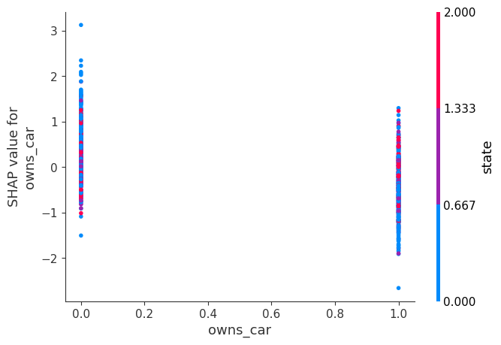
Note: The data and information in this document is reflective of a hypothetical situation and client. This document is to be used for KPMG Virtual Internship purposes only.
5.OLD CUSTOMER LIST SHAP DEPENDENCE CONTRIBUTION PLOTS AND INTERPRETATION OF INSPECTION
Owns car: Owns car has the following unique values ['Yes', 'No']
according to the ordinal encoder [0, 1] respectively
Owning car(0) and New State Wales(0) have a higher effect on the predictions
Not owning car(1) and New State Wales(0) seems to lower the predictions.
We could could for New State Wales owning a car is crucial for identifying high value customer.

Slide 42
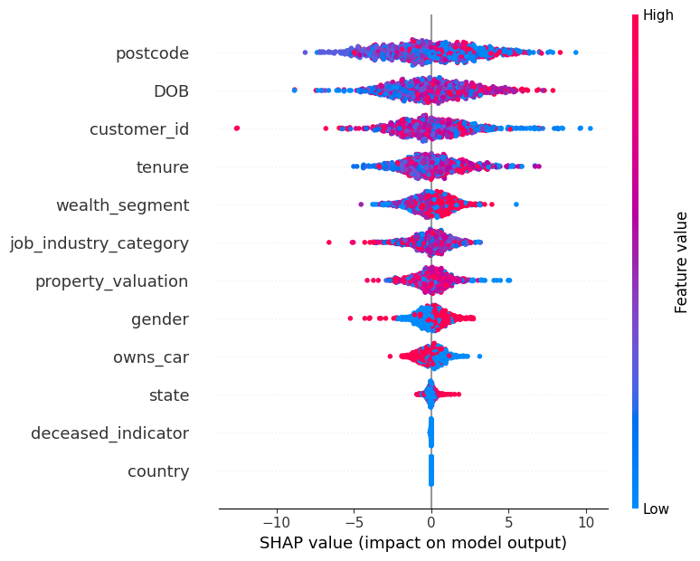
Note: The data and information in this document is reflective of a hypothetical situation and client. This document is to be used for KPMG Virtual Internship purposes only.
6. CONCLUSION OF OLD CUSTOMER LIST FEATURES INSPECTION
The following features will be used during the feature engineering process as suggested by the SHAP summary plot.
postcode
DOB
Customer Id
tenure
Wealth segment
job industry category
property valuation
Gender
Owns car

Slide 43
Note: The data and information in this document is reflective of a hypothetical situation and client. This document is to be used for KPMG Virtual Internship purposes only.
6. CONCLUSION OF OLD CUSTOMER LIST FEATURES INSPECTION
According to the SHAP summary plot, the following do not feature do not significantly affect the prediction.
Country.
Deceased Indicator.
State. According this has an interaction effect with other features.

Slide 44
Note: The data and information in this document is reflective of a hypothetical situation and client. This document is to be used for KPMG Virtual Internship purposes only.
FEATURE ENGINERING
TRANSACTIONS PRINCIPAL COMPONENT ANALYSIS (PCA) LOADINGS.
NEW TRANSACTIONS FEATURE DERIVED FROM THE PCA INFORMATION
CONCLUSION
OLD CUSTOMER LIST PRINCIPAL COMPONENT ANALYSIS (PCA) LOADINGS.
NEW OLD CUSTOMER LIST FEATURES DERIVED FROM THE PCA INFORMATION
CONCLUSION

Slide 45
TRANSACTIONS PRINCIPAL COMPONENT ANALYSIS (PCA) LOADINGS.
Note: The data and information in this document is reflective of a hypothetical situation and client. This document is to be used for KPMG Virtual Internship purposes only.
 | PC1 | PC2 | PC3 | PC4 | PC5 | PC6 | PC7
standard_cost | 0.545908 | 0.248490 | -0.360006 | -0.009863 | -0.100419 | 0.301687 | 0.639873
product_id | -0.149744 | 0.663788 | -0.450073 | -0.037846 | 0.286652 | -0.488939 | -0.108317
customer_id | 0.008955 | 0.045771 | 0.082038 | -0.991969 | -0.081229 | 0.016367 | -0.015013
product_line | -0.380214 | 0.428256 | -0.095740 | 0.071542 | -0.641892 | 0.450117 | -0.207649
product_class | -0.368836 | -0.236722 | -0.475466 | -0.086498 | 0.520177 | 0.549731 | -0.039791
brand | -0.378858 | -0.438802 | -0.432152 | -0.037920 | -0.413360 | -0.404545 | 0.375770
product_size | 0.505317 | -0.252101 | -0.488990 | -0.020717 | -0.218338 | -0.034470 | -0.626658

Slide 46
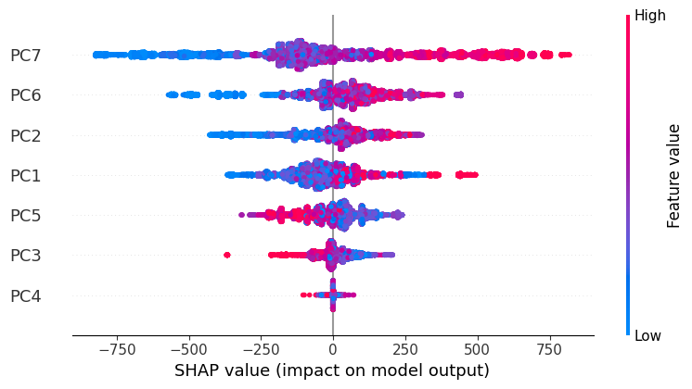
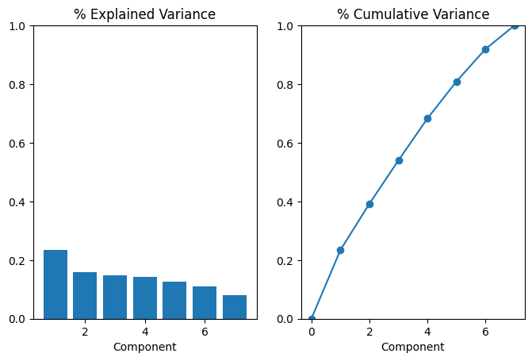
Note: The data and information in this document is reflective of a hypothetical situation and client. This document is to be used for KPMG Virtual Internship purposes only.
TRANSACTIONS PRINCIPAL COMPONENT ANALYSIS (PCA) LOADINGS.

Slide 47
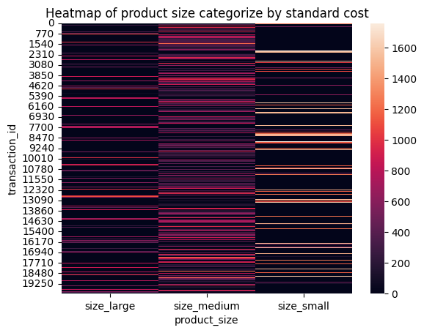
Note: The data and information in this document is reflective of a hypothetical situation and client. This document is to be used for KPMG Virtual Internship purposes only.
2. NEW TRANSACTIONS FEATURE DERIVED FROM THE PCA INFORMATION
3 new features:
Size large
Size medium
Size small
interaction between product size and standard cost
Pc1: product size(0.51) and standard cost(0.55)
Pc7: product size (-0.63) and standard cost(0.64)

Slide 48
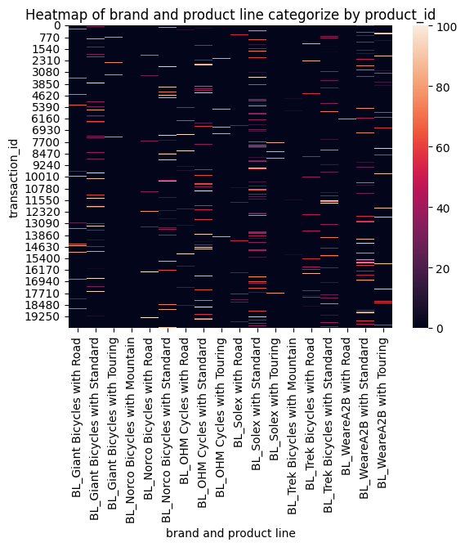
Note: The data and information in this document is reflective of a hypothetical situation and client. This document is to be used for KPMG Virtual Internship purposes only.
2. NEW TRANSACTIONS FEATURE DERIVED FROM THE PCA INFORMATION
18 new features:​
One hot encoding interactions.
Pc2: product id(0.66), product line(0.43), brand(-0.44)

Slide 49
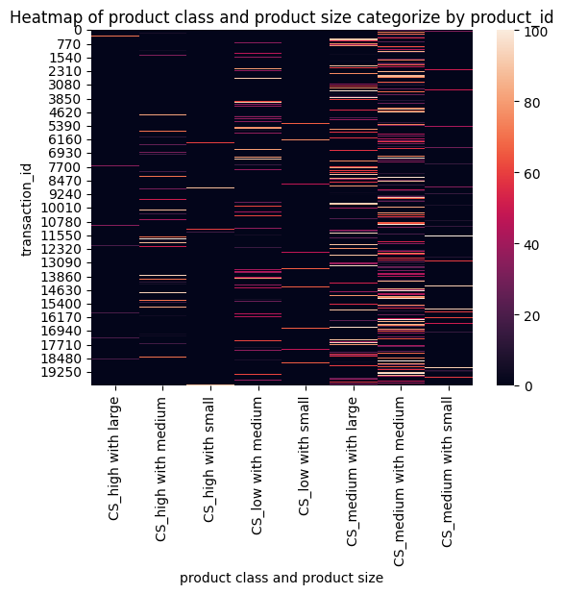
Note: The data and information in this document is reflective of a hypothetical situation and client. This document is to be used for KPMG Virtual Internship purposes only.
2. NEW TRANSACTIONS FEATURE DERIVED FROM THE PCA INFORMATION
8 new features:
interaction between;
product size(-0.49)
product class(-0.47)
Product id (-0.45)
PC3

Slide 50
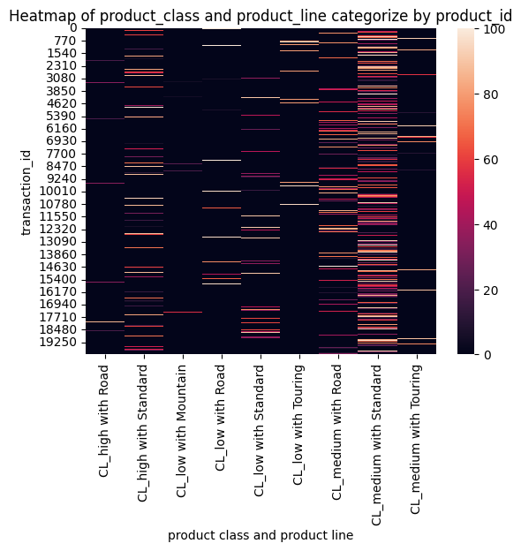
Note: The data and information in this document is reflective of a hypothetical situation and client. This document is to be used for KPMG Virtual Internship purposes only.
2. NEW TRANSACTIONS FEATURE DERIVED FROM THE PCA INFORMATION
8 new features: ​
Pc5:
product line(0.52) and
product class(-0.64)
Pc6:
product line(0.55),
product class(0.45),
Product id(-0.49)
​

Slide 51
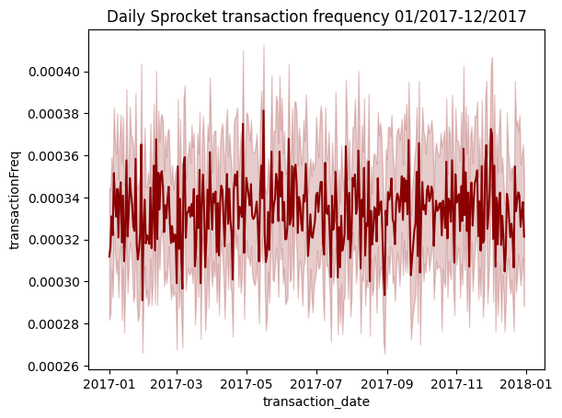
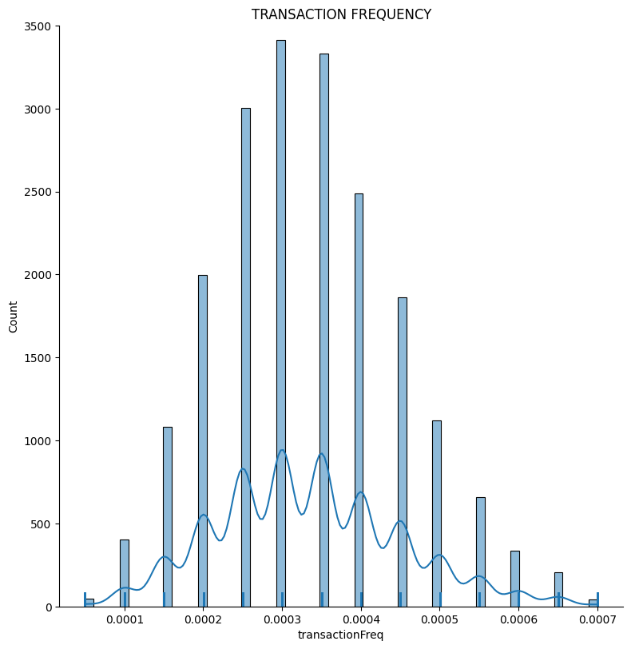
Note: The data and information in this document is reflective of a hypothetical situation and client. This document is to be used for KPMG Virtual Internship purposes only.
2. NEW TRANSACTIONS FEATURE DERIVED FROM THE PCA INFORMATION
Pc3: customer id(0.99), Feature Name: Transaction Frequency

Slide 52
Note: The data and information in this document is reflective of a hypothetical situation and client. This document is to be used for KPMG Virtual Internship purposes only.
2. NEW TRANSACTIONS FEATURE DERIVED FROM THE PCA INFORMATION
Approximately 80.5% of the total transactions are from customers with a transaction frequency ranging from 0.00020 to 0.0045.
Main Focus (80.5%)
Offer incentives and improved services to maintain loyalty.
Targeted marketing campaigns to encourage increased transaction frequency
11.7% of the total transactions are from customers with the highest transaction frequency rate 0.50 to 0.70.
High-Value Segment (11.7%)
Segmentation and profiling to understand demographics and behavior will be carried out in the appendix section.
Use demographic profiling as lookalike targeting for new customers.
Personalized offers and premium services to retain and upsell.
7.7% of the total transaction are from customers are with a transaction frequency ranging from 0.00005 to 0.00015
Churn Risk Segment (7.7%)
Targeted campaigns to re-engage and increase transaction frequency.
Incentives and loyalty programs to retain customers at risk of churn

Slide 53
Note: The data and information in this document is reflective of a hypothetical situation and client. This document is to be used for KPMG Virtual Internship purposes only.
2. NEW TRANSACTIONS FEATURE DERIVED FROM THE PCA INFORMATION
The heatmaps identifies important purchasing pattern of the customers:
Preference for standard product line: customers tend to prefer standard product line, with a high count of transactions in this category across various brands and classes.
Brand Loyalty: Solex and Giant lead the market, with a high transaction count for Standard product line. Trek Bicycles and Norco Bicycles are popular for Road products line.
Medium Class Preference: Medium product class have the highest transaction count, indicating a strong demand.
Medium Size Dominance: Medium product size dominate, with most transactions falling in this category.
Product ID Correlation: A high variation of unique product IDs is seen in:
Solex brand and Standard product lines
Medium product class and medium product size
Product IDs with high demand are linked to specific product attributes
Price Strategy: Customers tend to prefer products with variations in price strategy (standard cost and list price), with Medium product size products having a higher variation in standard cost.
The MAE for the dataset after the new feature
 | MAE score | Cross validation score
Old Customer List | 4.93 | 5.89

Slide 54
Note: The data and information in this document is reflective of a hypothetical situation and client. This document is to be used for KPMG Virtual Internship purposes only.
3. OLD CUSTOMER LIST PRINCIPAL COMPONENT ANALYSIS (PCA) LOADINGS.
 | PC1 | PC2 | PC3 | PC4 | PC5 | PC6 | PC7 | PC8 | PC9
postcode | 0.686411 | -0.151170 | 0.037373 | 0.039704 | -0.051434 | -0.043737 | -0.012469 | -0.021967 | -0.705562
DOB | 0.174258 | 0.683903 | 0.002809 | -0.029866 | 0.013749 | -0.003472 | -0.037998 | 0.706658 | -0.000649
customer_id | 0.033647 | 0.004156 | -0.601359 | 0.305623 | -0.232755 | 0.371897 | 0.591302 | 0.041137 | -0.000629
tenure | -0.144816 | -0.690492 | 0.057522 | -0.009098 | -0.005215 | -0.014256 | 0.034136 | 0.705212 | -0.011705
job_industry_category | 0.021452 | -0.064592 | -0.592179 | 0.189295 | 0.483819 | 0.133819 | -0.596458 | 0.026731 | -0.019862
wealth_segment | 0.007502 | -0.031796 | -0.163484 | -0.634084 | -0.491198 | 0.470289 | -0.327681 | -0.002995 | -0.017691
property_valuation | -0.685734 | 0.164656 | -0.017650 | -0.009091 | 0.025875 | 0.019056 | 0.021397 | 0.009521 | -0.707589
owns_car | -0.072259 | 0.016272 | 0.079562 | 0.620910 | -0.639885 | -0.098009 | -0.427406 | 0.017006 | 0.025117
gender | 0.020010 | 0.008226 | 0.499609 | 0.283791 | 0.239760 | 0.781355 | -0.036436 | -0.005678 | -0.004954

Slide 55
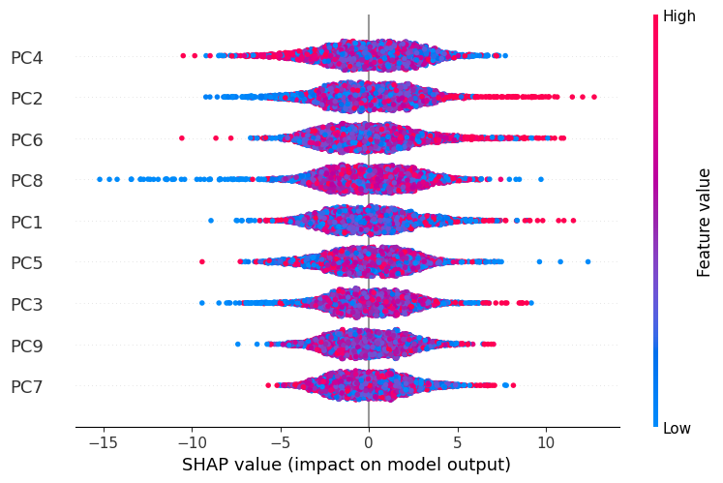
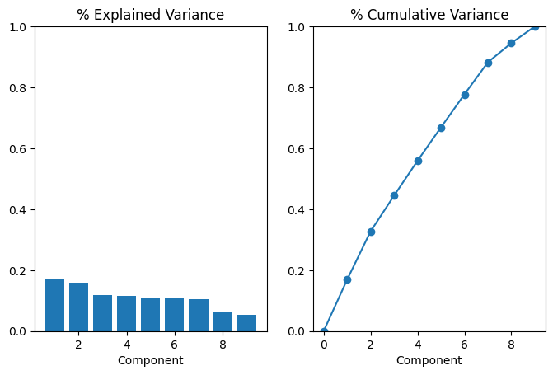
Note: The data and information in this document is reflective of a hypothetical situation and client. This document is to be used for KPMG Virtual Internship purposes only.
3. OLD CUSTOMER LIST PRINCIPAL COMPONENT ANALYSIS (PCA) LOADINGS.

Slide 56
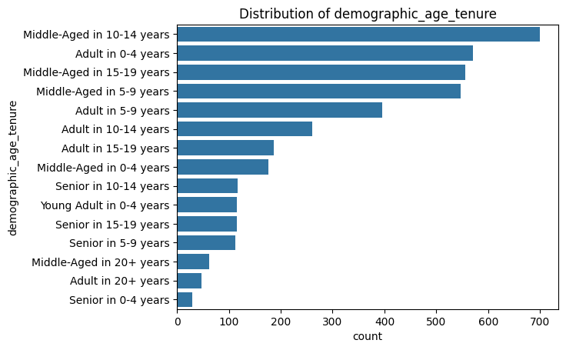
Note: The data and information in this document is reflective of a hypothetical situation and client. This document is to be used for KPMG Virtual Internship purposes only.
4. NEW OLD CUSTOMER LIST FEATURES DERIVED FROM THE PCA INFORMATION
New feature: Demographic age tenure
PC2:
DOB(0.68) and
tenure(-0.69)
PC8:
DOB(0.71) and
tenure(0.71)

Slide 57
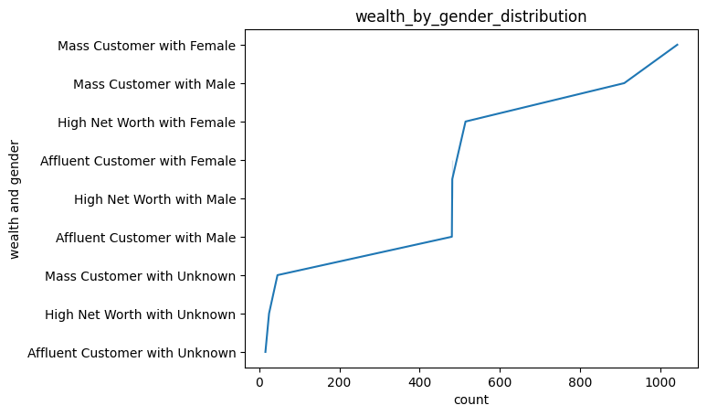
Note: The data and information in this document is reflective of a hypothetical situation and client. This document is to be used for KPMG Virtual Internship purposes only.
4. NEW OLD CUSTOMER LIST FEATURES DERIVED FROM THE PCA INFORMATION
New feature: wealth and gender
PC6:​
Wealth segment (0.47) and
Gender(0.78)

Slide 58
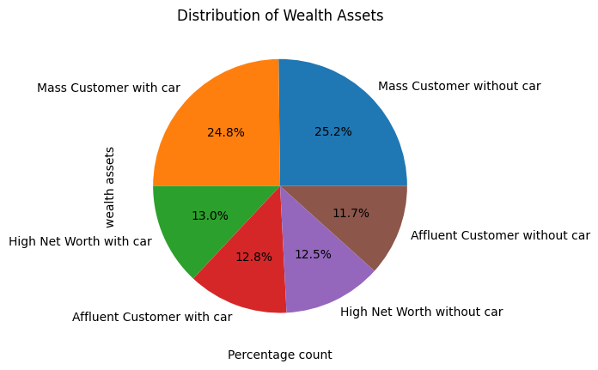
Note: The data and information in this document is reflective of a hypothetical situation and client. This document is to be used for KPMG Virtual Internship purposes only.
4. NEW OLD CUSTOMER LIST FEATURES DERIVED FROM THE PCA INFORMATION
New feature: wealth Assets
​
PC4:​​
Owns car(0.62) and
wealth segment(-0.63)

Slide 59
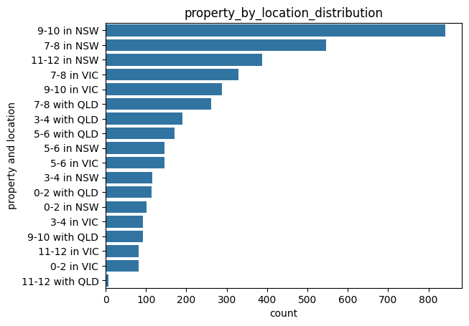
Note: The data and information in this document is reflective of a hypothetical situation and client. This document is to be used for KPMG Virtual Internship purposes only.
4. NEW OLD CUSTOMER LIST FEATURES DERIVED FROM THE PCA INFORMATION
New feature: Property location
​​
PC1:​​​
Postcode (0.68) and
Property valuation(-0.69)
PC9:
Postcode (-0.71) and
Property valuation(-0.71)

Slide 60
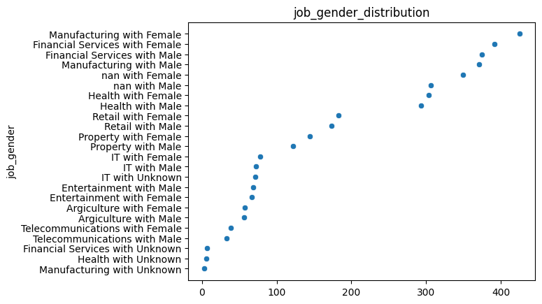
Note: The data and information in this document is reflective of a hypothetical situation and client. This document is to be used for KPMG Virtual Internship purposes only.
4. NEW OLD CUSTOMER LIST FEATURES DERIVED FROM THE PCA INFORMATION
New feature: Job gender
PC3
Customer id(0.60),
Job industry category(-0.59)
gender(0.50)

Slide 61
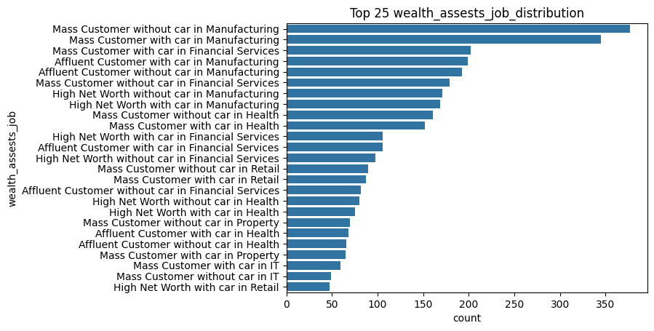
Note: The data and information in this document is reflective of a hypothetical situation and client. This document is to be used for KPMG Virtual Internship purposes only.
4. NEW OLD CUSTOMER LIST FEATURES DERIVED FROM THE PCA INFORMATION
New feature: Wealth Asset Job
PC5
Job industry category(0.48),
Owns car(-0.64) and
Wealth segment(-0.49)
PC7
Customer id(0.59),
Job industry category(-0.60)
Owns car(0.43)

Slide 62
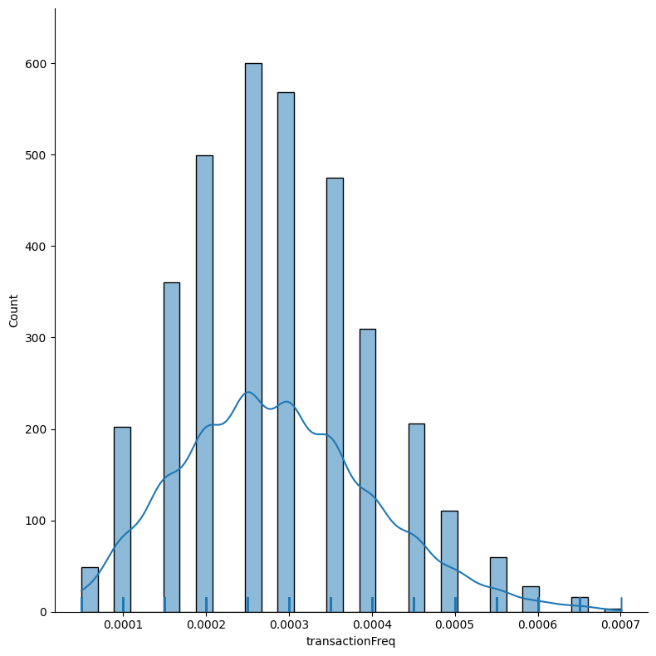
Note: The data and information in this document is reflective of a hypothetical situation and client. This document is to be used for KPMG Virtual Internship purposes only.
5. CONCLUSION
Customer Segmentation Analysis
Main Segment (66.5%)
Customers with transaction frequency between 0.00020 and 0.0045
Strategic Focus: Retention and loyalty initiatives
High-Value Segment (5.5%)
Customers with transaction frequency between 0.50 and 0.70
Strategic Focus: Personalized engagement and upselling
Churn Risk Segment (15.3%)
Customers with transaction frequency between 0.00005 and 0.00015
Strategic Focus: Re-engagement and retention
Inactive Segment (12.7%)
Customers with no transaction frequency (no transactions initiated)
Strategic Focus: Reactivation and acquisition

Slide 63
Note: The data and information in this document is reflective of a hypothetical situation and client. This document is to be used for KPMG Virtual Internship purposes only.
5. CONCLUSION
Demographic Profiling
Age:
Middle-aged (45-65 years): 51%
Adults (25-45 years): 37%
Gender:
Female: 51%
Male: 47%
Wealth Segment:
Mass customer wealth segment: 50%
Postcode:
New South Wales (NSW): 53.5%
Victoria (VIC): 25.5%
Queensland (QLD): 21%
Job Industry Category:
Manufacturing: 36%
Financial Services: 19%
Health: 15%
Demographic Profiling
Tenure:​
Middle-aged: - total 45%
10-14 years​ - 18%,
15-19 years - 14%,
5-9 -13%
Adults: 0-4 years​ -14%
Owns Car:​
Mass customer wealth segment: owns car (25%) and not owning car (25%)​
Other wealth segments: owning a car leads (26%)​
Property Valuation:​
NSW: 9-10 - 21%, 7-8 -14%, 11-12 – 10%
VIC and QLD: 7-8 (moderate value)
The MAE for the dataset after the new feature is:
 | MAE score | Cross validation score
Old Customer List | 24.75 | 25.22

Slide 64
Note: The data and information in this document is reflective of a hypothetical situation and client. This document is to be used for KPMG Virtual Internship purposes only.
Model Development
PREDICT CUSTOMER TRANSACTON FREQUENCY
DATA PREPROCESSING.
RANDOM FOREST REGRESSOR
MODEL OPTIMIZATION
DATA PIPELINE
MODEL PREDICTION
MODEL EVALUATION
PREDICTION NEW CUSTOMER LIST
INTREPRETATION

Slide 65
Note: The data and information in this document is reflective of a hypothetical situation and client. This document is to be used for KPMG Virtual Internship purposes only.
DATA PREPROCESSING
Good Label columns
These are columns that can be safely ordinal encoded between the old and New customer list
gender
Job industry category
Wealth segment
Owns car
State
Tenure category
Age category
Wealth assets
Wealth gender
Property valuation category
Property location
Wealth assets job
Bad Label columns​
These are columns that can be safely ordinal encoded between the old and New customer list​.
Deceased indicator
Job gender
Demographic age tenure
Country​
Y.dot notation
The transaction frequency captures transaction frequency of the customers.
Mean Absolute Error (MAE): 9.52041086965337e-05 (a significant reduction from 24.93)
This feature provides a more accurate representation of customer behavior
X-features: the columns imputed into the model is the good label columns and the numeric columns of the Old Customer List dataset.

Slide 66
Note: The data and information in this document is reflective of a hypothetical situation and client. This document is to be used for KPMG Virtual Internship purposes only.
2. Random Forest Regressor
The random forest uses many trees, and it makes a prediction by averaging the predictions of each component tree.
The random forest regressor was chosen for the following but not limited to:
its robustness and accuracy
It handles non-linear relationships
Reduces overfitting
Easy to interpret

Slide 67
Note: The data and information in this document is reflective of a hypothetical situation and client. This document is to be used for KPMG Virtual Internship purposes only.
3. Random Forest Regressor Optimization
Key Performance Metric
Best MAE: 0.000092
Optimized Model Parameters
Max Depth: 10
Max Features: Square Root (sqrt)
Min Samples per Leaf: 4
Min Samples per Split: 2
Number of Estimators: 400
Business Implications
High prediction accuracy supports better decision-making.
Efficient model operation balances performance with resource use.

Slide 68
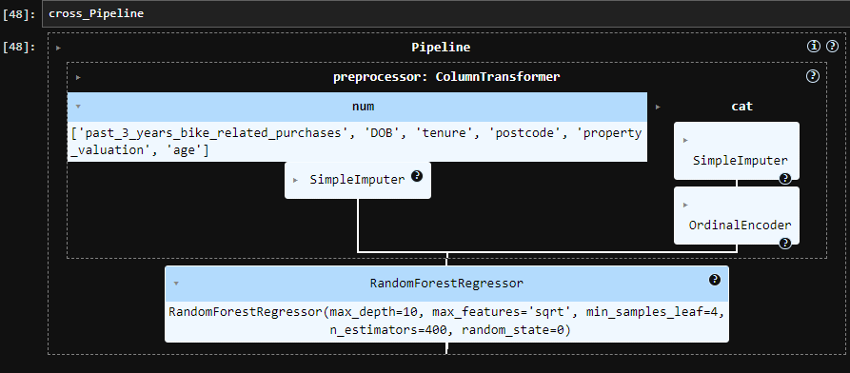
Note: The data and information in this document is reflective of a hypothetical situation and client. This document is to be used for KPMG Virtual Internship purposes only.
4. DATA PIPELINE

Slide 69
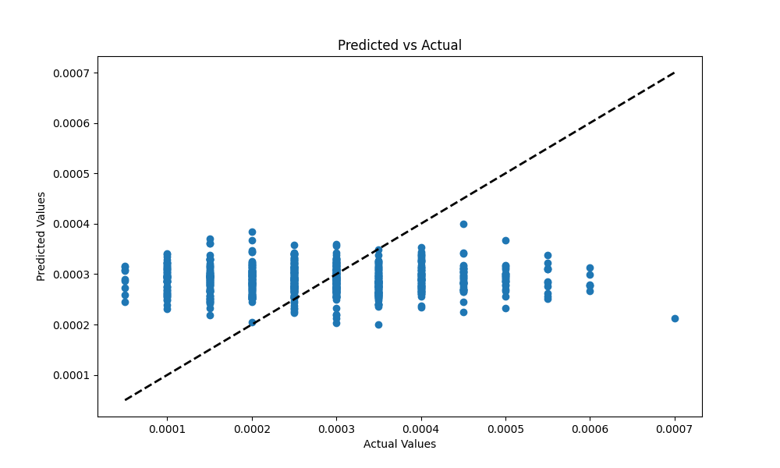
Note: The data and information in this document is reflective of a hypothetical situation and client. This document is to be used for KPMG Virtual Internship purposes only.
4. MODEL PREDICTION

Slide 70
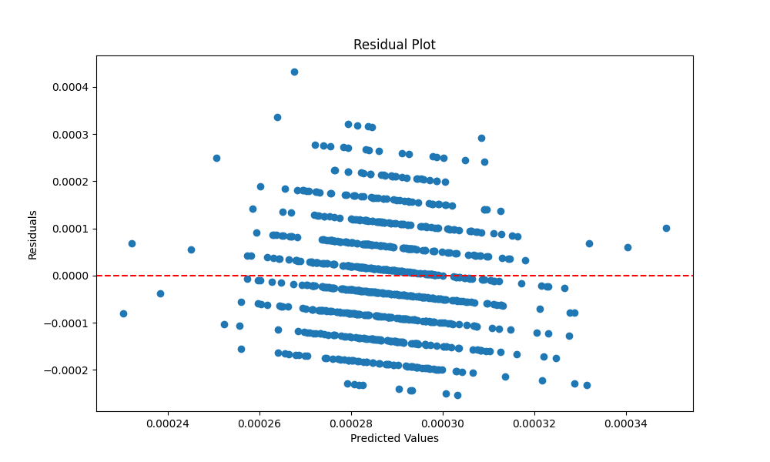
Note: The data and information in this document is reflective of a hypothetical situation and client. This document is to be used for KPMG Virtual Internship purposes only.
4. MODEL EVALUATION
Statistical Significance
T-statistic: -0.9418622785744097
P-value: 0.3464263449041912
Cross Validation Score: 0.000094
Mean Absolute Error: 0.000092
R-Squared (R²): -0.06451813912247406
Residual Analysis: Residual plot showing the distribution of prediction errors.

Slide 71
Note: The data and information in this document is reflective of a hypothetical situation and client. This document is to be used for KPMG Virtual Internship purposes only.
5. MODEL INTERPRETATION
Key Performance Metric
Mean Absolute Error (MAE): The MAE is extremely low, indicating that the model's predictions are highly accurate
Cross Validation Score: The cross-validation score is very low, indicating that the model performs consistently well across different subsets of the data.
The negative R² value typically indicates that the model does not fit the data well in a conventional sense.
Visual Analysis
Residual Plot: Ideally, residuals should be randomly dispersed around the horizontal axis (red line).
The plot shows some pattern and dispersion, suggesting potential issues with model assumptions or areas where the model could be improved.
Predicted vs Actual: Ideally, the points should align along the diagonal line (indicating perfect predictions).
the points are relatively close to the diagonal, indicating that the model's predictions are generally accurate
Statistical Significance: Since the p-value is 0.3465, which is greater than 0.05, we conclude that
there is no significant difference between the predicted transaction frequency and the actual frequency.
the differences observed in the data might not be due to a real underlying effect but rather due to random variation.

Slide 72
Note: The data and information in this document is reflective of a hypothetical situation and client. This document is to be used for KPMG Virtual Internship purposes only.
Appendix

Slide 73
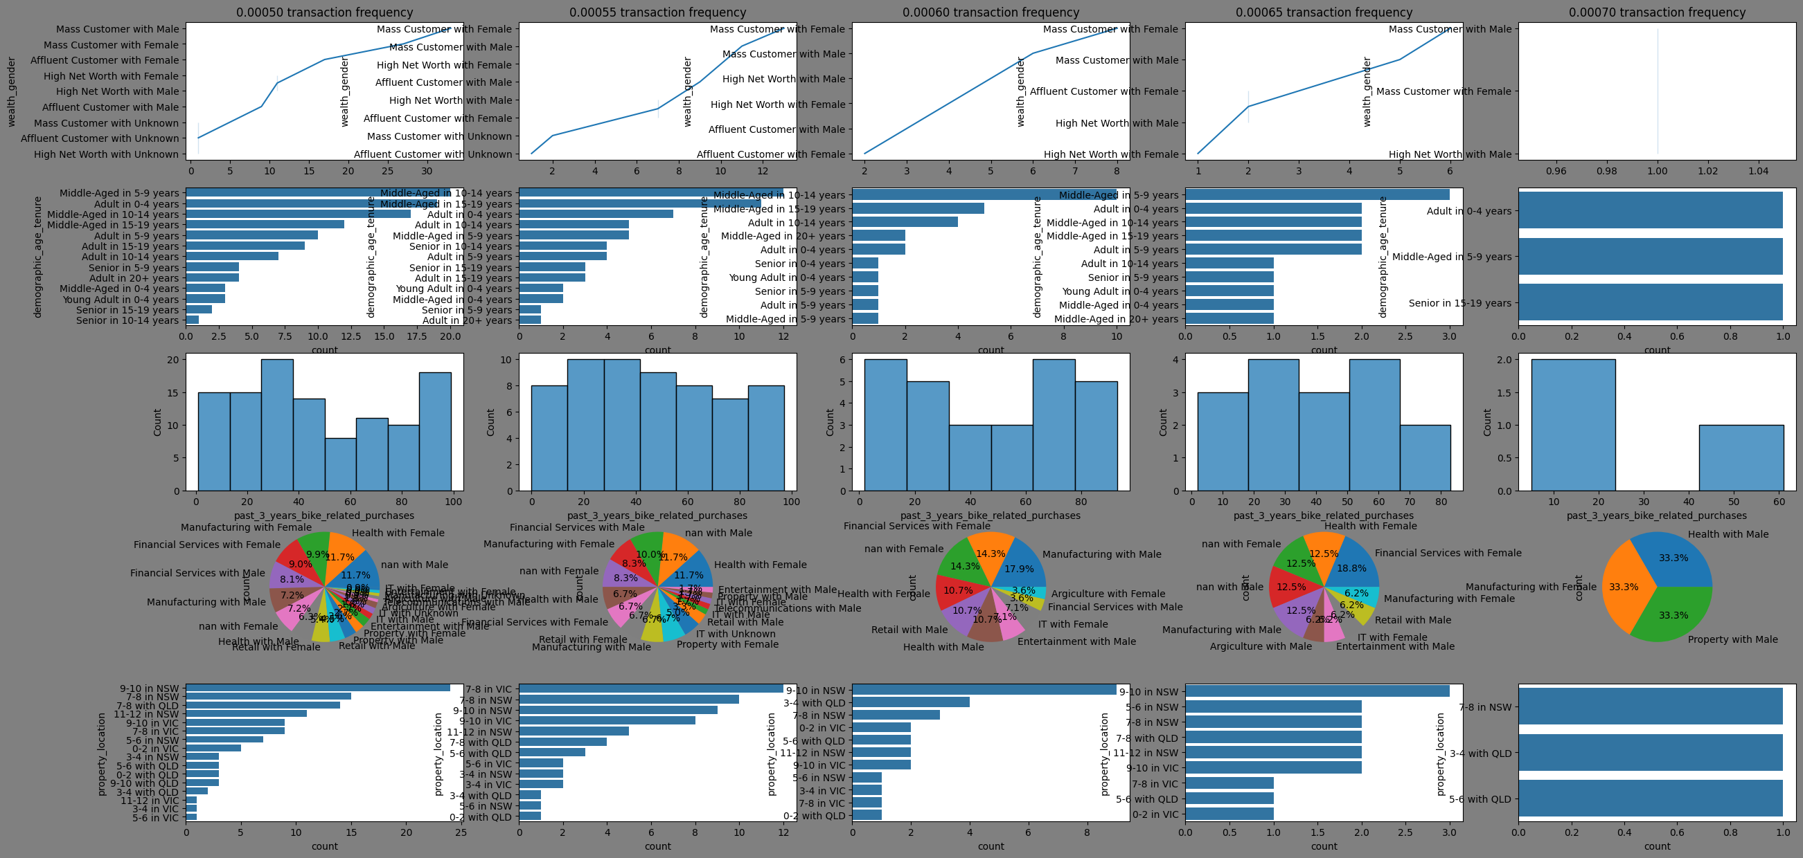
Note: The data and information in this document is reflective of a hypothetical situation and client. This document is to be used for KPMG Virtual Internship purposes only.
SEGMENTEATION AND PROFILING OF HIGH VALUE CUSTOMER IN OLD CUSTOMER LIST

Slide 74
Note: The data and information in this document is reflective of a hypothetical situation and client. This document is to be used for KPMG Virtual Internship purposes only.
SEGMENTEATION AND PROFILING OF HIGH VALUE CUSTOMER IN OLD CUSTOMER LIST
Based on the graph in the previous slide. The following are recommendation for lookalike targeting.
Target middle-aged: Across all transaction frequencies, middle-aged (45-65 years) are the most significant target audience
They are highly represented in the mass customer wealth segment.
They are more likely to have a higher transaction frequency
Focus on specific job industries: Target females in the Health, Manufacturing, and Financial Services industries
Target males in Financial Services, Health, and Manufacturing
Property valuation is important: Target customers with property valuations between 7-10, with a focus on the 9-10 range.
NSW and VIC postcodes are key: Target customers living in postcode areas in NSW and VIC
Target specific tenure ranges: Focus on customers with a tenure of 5-14 years for middle-aged individuals and 0-4 years for adults.

Slide 75
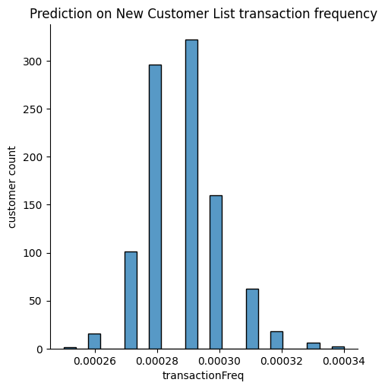
Note: The data and information in this document is reflective of a hypothetical situation and client. This document is to be used for KPMG Virtual Internship purposes only.
FORCASTED NEW CUSTOMER LIST TRANSACTION FREQUENCY
The plot is the model prediction of the new customer list transaction frequency
Majority of the customer are having a transaction frequency between 0.0027 and 0.00032.
Use the lookalike targeting recommendation above to target new customers within this transaction frequency range.
Profiling of the new customer in the next slide shows a visual representation of this.

Slide 76
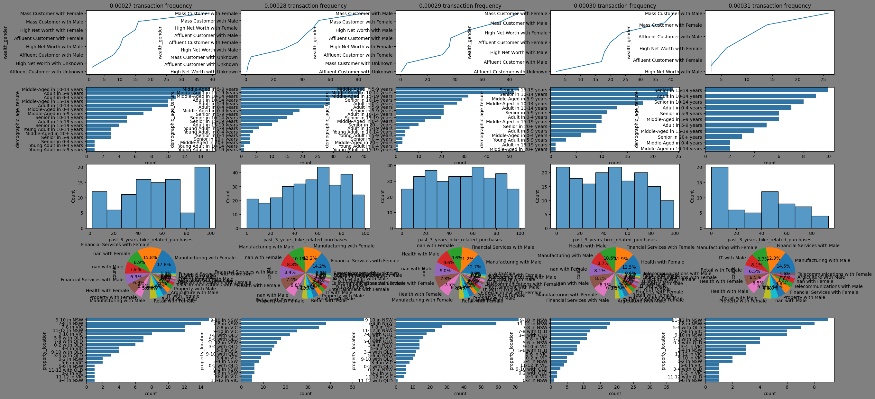
Note: The data and information in this document is reflective of a hypothetical situation and client. This document is to be used for KPMG Virtual Internship purposes only.
SEGMENTEATION AND PROFILING OF HIGH VALUE CUSTOMER IN OLD CUSTOMER LIST

Slide 77
Note: The data and information in this document is reflective of a hypothetical situation and client. This document is to be used for KPMG Virtual Internship purposes only.
JUPYTER NOTEBOOK LINK
Jupyter Notebook

